Slide 1
Theme: Road Safety Auto Rickshaw: Traffic Safety By: Nishant Jain, Itisha Goyal, Harshit Mittal
1

Slide 2
A basic introduction to our prototype
1
The prototype is all software based for now.
It takes any camera feed in input and returns the speed, type, license plate number, current location of vehicle(with help of ML and image processing).
Speed limits are then set and an image of vehicles breaching that limit is captured.
Multiple images are captured to ensure the best possible view of the vehicle’s number plate.
Through OCR, the number plate can be read.
The data obtained is then sent through E-mail to the concerned authorities.

Slide 3
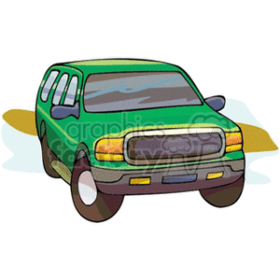
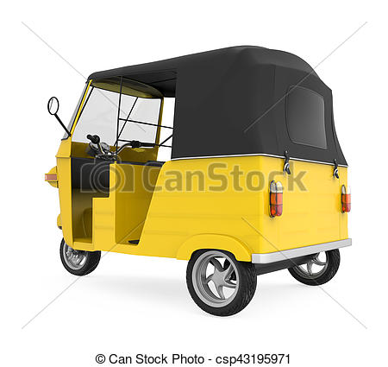
Cameras capturing the vehicle view
1

Slide 4
How this thing works
1
Input video is read frame by frame with OpenCV.
Object is then detected using TensorFlow object detection API.
Speed and direction are predicted using Pixel locations.
Vehicle size is predicted with the help of image area.
Vehicle number is read through OCR using openALPR API.
Location is determined through geocoder package.

Slide 5
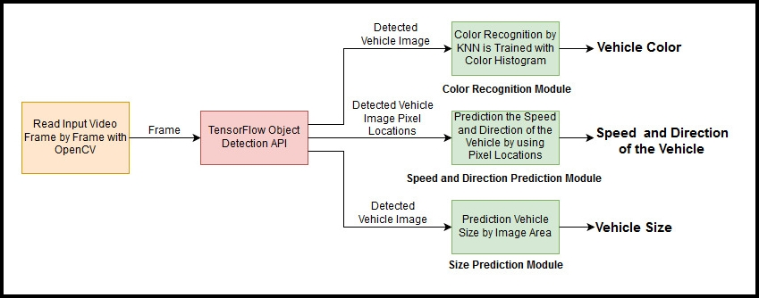
Explanation through a flow chart
1

Slide 6
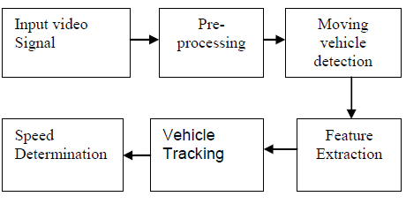
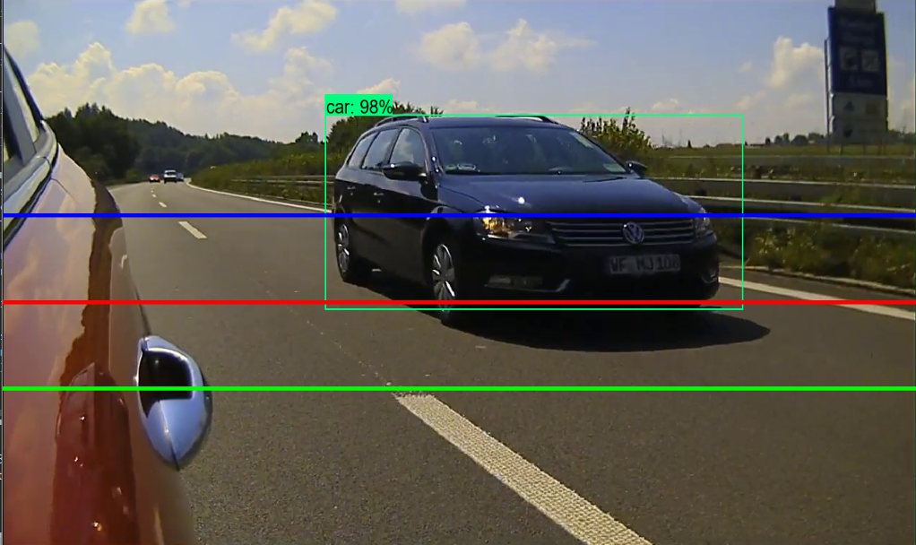
Vehicle detection
1
Flow of control
A snap of detected vehicle

Slide 7
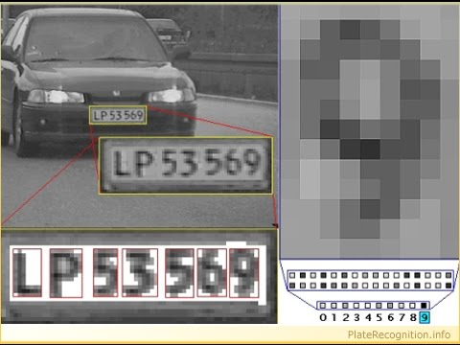
The flow ahead…
1
As soon as the vehicle images are captured, the number plates are detected by feeding those images in OCR software.

Slide 8
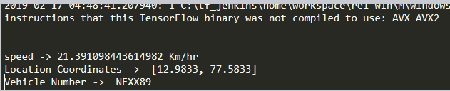
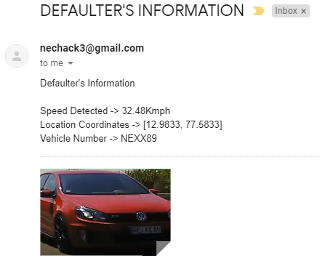
Parameter detection and information sent
1
Parameters returned by python script
A snap of Email sent with all the details

Slide 9
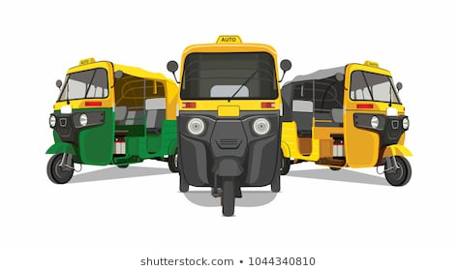
Why this is best suited on auto rickshaw
1
Beneficial to auto drivers as well.
Help cover a wide area
Speed violations can be detected in narrow roads as well
A double advantage

Slide 10
Taking the idea to industry
1
How the cameras will be mounted?
There will be 2 cameras mounted on rear and front side of Auto, taking the diagonal view, of the traffic passing by.
Benefit for Auto Rickshaw driver
The driver will reap rewards from government in the form of
subsidies and a free internet connection.
A way to minimize detection error
To reduce the fallacy that might be there in image processing, we are attaching, with the details, the vehicle image.
A cost effective solution
We are detecting speed without speed cameras that are quite expensive, thus cutting down their cost.

Slide 11
Reasons why this idea might flourish
1
This is a time when traffic accidents are at an all time high.
An innovative way of catching more rule breakers.
Helping traffic police to a good extent.
Quite cost effective.

Slide 12
Challenges we may counter
1
Minimizing the damage to the cameras.
Training model for better accuracy.
Making the whole process faster and more efficient.
Doing all these things in real time.

Slide 13
The final goal…
1
We wish that with our idea, we are able to contribute our part, even if a little one, to help and reduce these road accidents, to ensure that no lives are harmed and people travel safely on the roads.

Slide 14
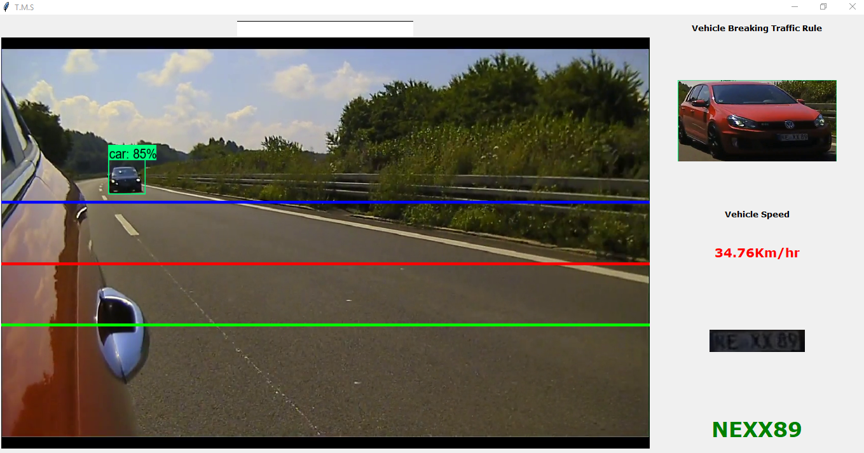
<number>
ARIGATOU (ありがとう)

